Slide 1

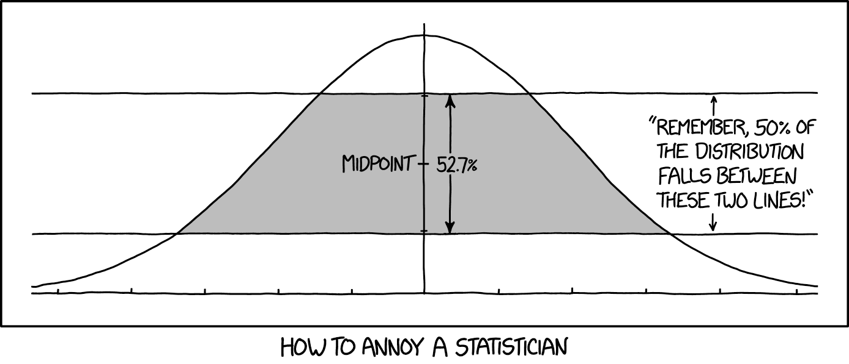
Fitting Gaussian curves on data points
The Maximum Likelihood and the Bayesian approach
Gosztolya Gábor
Szegedi Tudományegyetem
Informatikai Intézet
2023 / Mar / 09

Slide 2
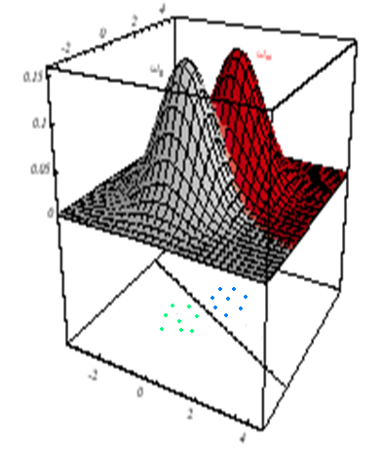
Where are we?
Classification, from a decision theory point of view::
  Let us have a g_{i}(x) discriminatory function
  for all classes
  It should be “big” for the feature space regions
  belonging to the given class and “small” otherwise
  Classification is done on the base of max g_{i}(x)
  This implicitely sets the decision boundary
  between the classes
Bayes decision rule: we need g_{i}(x) = P(c_{i}|x) for optimal classification
  This is equivalent to e.g. g_{i}(x) = p(x|c_{i}) · P(c_{i}) , we used this form in the last lecture, and we will use this now

Slide 3
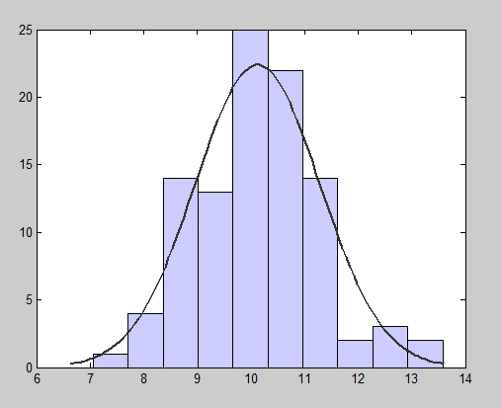
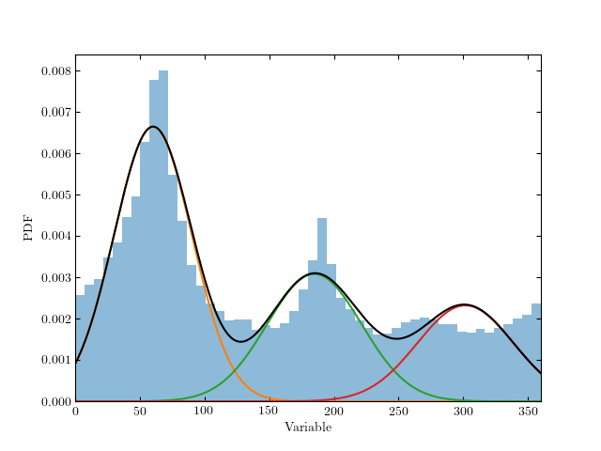
Where are we? #2
We assumed that p(x|c_{i}) is Gaussian for all classes
  And we examined how the decision surfaces look like for given parameters Σ_{i} and μ_{i}
We will still assume that the distribution is Gaussian
  But now we will learn how to estimate the Σ_{i} and μ_{i} parameters from the data

Slide 4
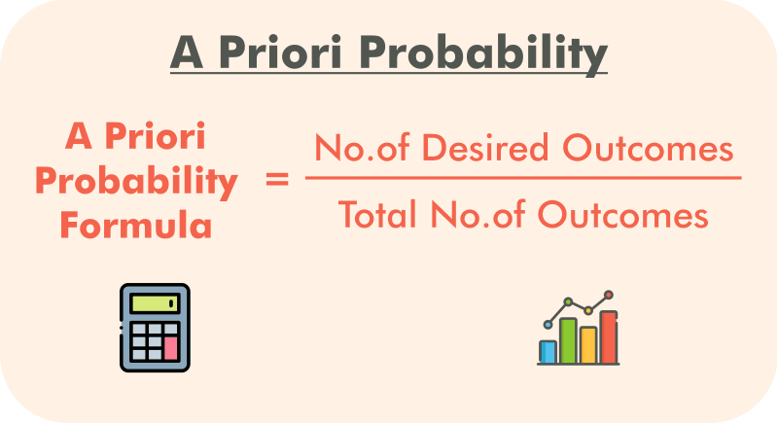
Parameter estimation for Gaussians
We want to estimate p(x|c_{i}) and P(c_{i}) from data samples
The class priors form a discrete distribution, so they can easily be estimated by simple counting
  E.g. we have 2 classes, 60 examples from class 1 and 40 from class 2
  Then we can estimate
  P(c₁) ≈ 60 / (60+40),
  P(c₂) ≈ 40 / (60+40)

Slide 5
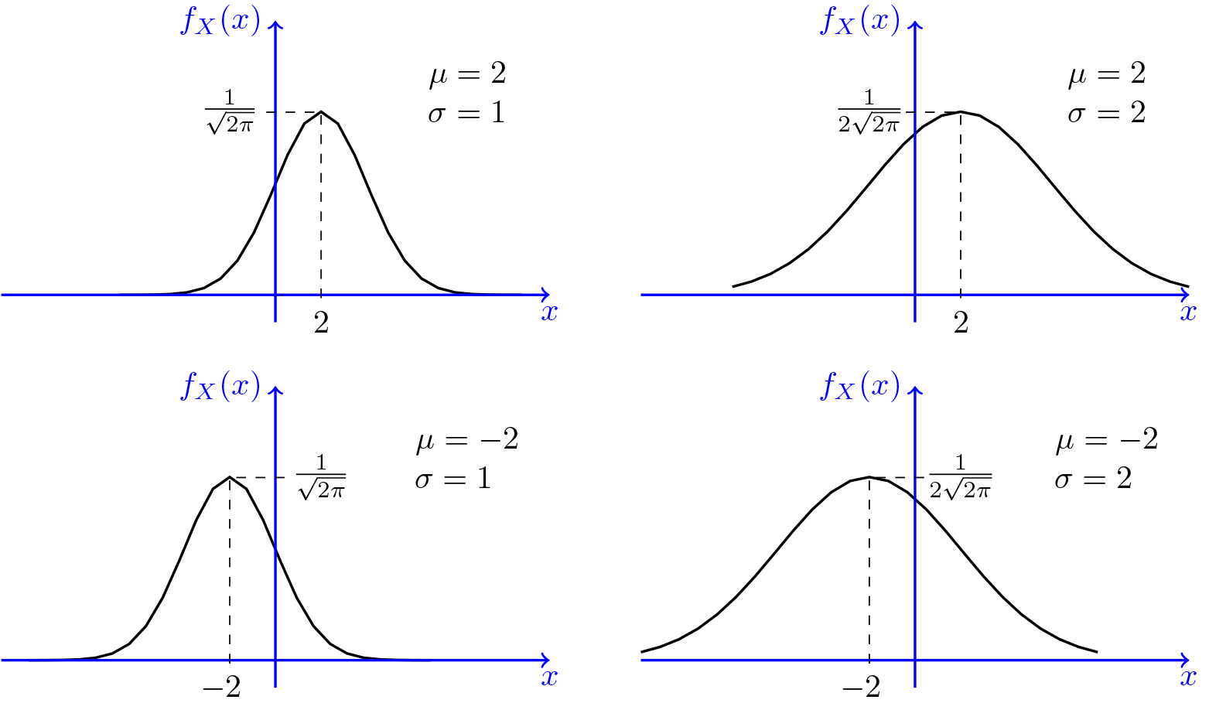
Gauss-eloszlások paramétereinek becslése
If the features are continuous, then p(x|c_{i}) is a multivariate continuous distribution, much more difficult to estimate
We will assume that p(x|c_{i}) is Gaussian
  As a Gaussian is defined by Σ_{i} and μ_{i}, we will have to estimate these parameters from the data
  We will do this for each class separately, independently of the other classes
  So we will temporarily drop index i from the formulas

Slide 6
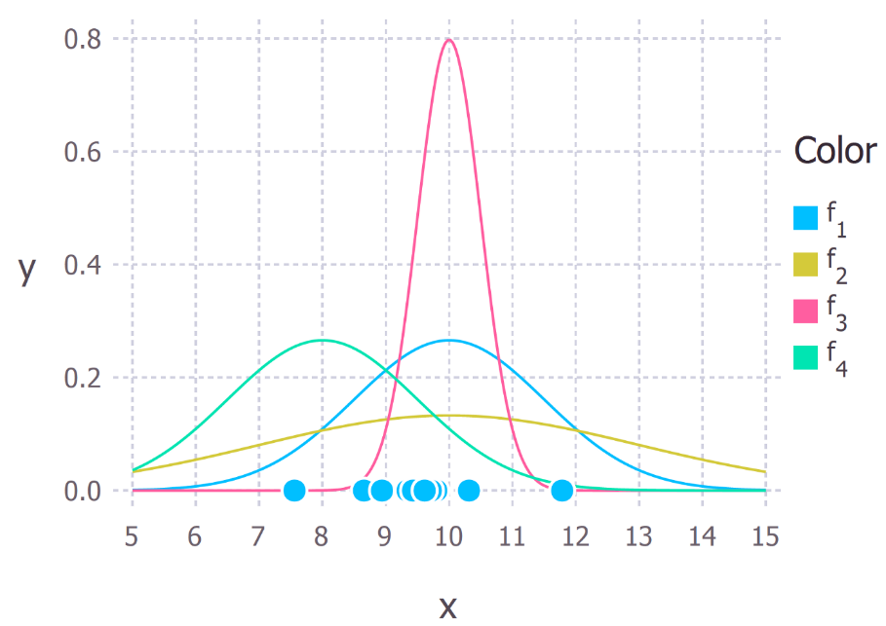
Parameter estimation approaches
We will examine two approaches for estimating the parameters
  Maximum likelihood approach: simpler, more frequently used in practice
  Bayes approach: theoretically more involved, less frequently used in practice
  Fortunately, they will give very similar results
During classification we will calculate the result in the same way
  i.e. with the Bayes decision (calculate the likelihood of all classes, then select the most likely one)

Slide 7

Maximum likelihood approach
We try to estimate p(x|c_{i})
We assume that the parameters Σ and μ have concrete values, but they are unknown to us
It will select those parameter values that give the best explanation to the data
  Assigns the highest likelihood value
  → maximum likelihood
  We could call it “maximum probability” as well, but not everything between 0 and 1 is a probability

Slide 8
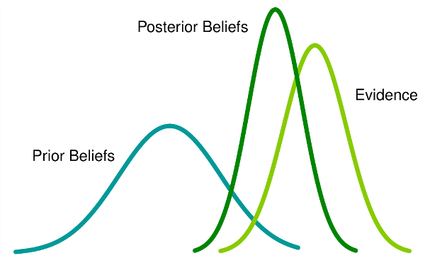
Bayesian approach
We try to estimate p(x|c_{i})
AIt treats the parameters not as numbers with missing values, but as stochastic variables
  …that also have a probability distribution
  1) we try to model this probability distribution
  2) …then we use this model to estimate the distribution of data
  We will first assume an a priori distribution for the parameters, and then refine this model based on the observed data

Slide 9
Maximum Likelihood estimation
This is the simplest possible solution
If the data indeed has a Gaussian distribution, then it quickly converges to the real parameter values when the amount of training data is increases
We will assume that the data in each class has a Gaussian distribution, and we will estimate these separately for each class
We will shortly notate the parameters as θ = (μ_{i} , Σ_{i})
The training data set will be shortly denoted by D ( = { x₁, …, x_{n} } )
  We assume that the data samples are independent and identically distributed (“i.i.d.” for short)

Slide 10
The “Likelihood” target function
We will seek to maximize the likelihood
The maximum likelihood estimate of θ will be that value that maximizes P(D | θ)
  Explanation #1: This is the θ value by which the likelihood curve gives the best explanation for the data
  Explanation #2: Consider that when applying the Bayes decision rule, we will select the class for which the likelihood curve gives the largest value.
  So during training, to increase the chance of correct classification, we seek to achieve the largest possible likelihood value for the samples that belong to the given class (and as low as possible for the others)

Slide 11
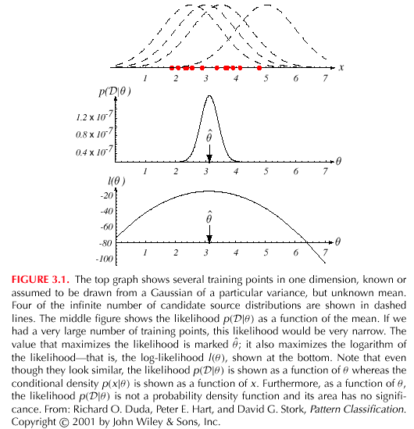
The “Log-likelihood” target function
Just as earlier, we will use the logarithmized version of the target function – its takes its optimum at the same point, but easier to handle
Example: 1D Gaussian, σ² is known, we seek the optimal value of μ
  1) The training points and four candidates
  2) The likelihood function (as a function of θ) and its optimum point
  3) The log-likelihood function and its optimum point

Slide 12

Maximizing the log-likelihood
We show the optimization process formally– first for simpler cases
Example: 1D Gaussian, we seek the optimal value for μ and σ
We want to maximize wrt. θ = (θ₁, θ₂) = (μ, σ²)
Replacing the variables and taking the logarithm, the log-likelihood function becomes
  (the exponent is negative)

Slide 13
Maximizing the log-likelihood #2
(recap)
Using the following:
…the log-likelihood target function becomes:
x_{k} is a single training example, we can sum up to get this for D
  i.i.d. assumption and the properties of logarithm

Slide 14
Maximizing the log-likelihood #3
At start:
The maximum point is where the derivative is zero:
…so:

Slide 15
Maximizing the log-likelihood #4
Summing over all the data points:
After rearranging (and also multiplying by θ₂):

Slide 16
Maximizing the log-likelihood #5
That is, we estimate μ as the mean of the data points, and σ² as their average distance from μ:
These values as the so-called “sufficient statistics” for a normal distribution
  This means that we don’t need the original data values
  Only these two statistics are enough to estimate the distribution

Slide 17
Multivariate case
In the general case the features are vectors
  So the Gaussian distribution is multivariate
We apply the same method – setting the derivative of the
log-likelihood function to zero
  But as the function is multivariate, we need to use the gradient operator instead of the univariate derivative
So we seek to find:
And we apply the gradient operator:

Slide 18
Maximizing the log-likelihood
Applying the gradient operator to the log-likelihood function and summarizing for all examples gives
  And we set ∇_{θ}l = 0
And the result is (without derivation):
Very similar to the univariate case!
  These are just the mean vector and the covariance matrix of the data

Slide 19
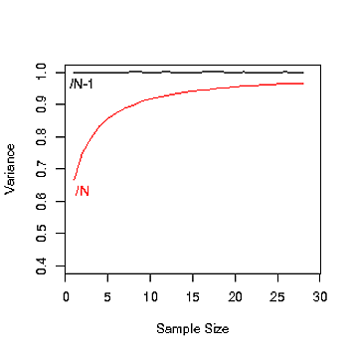
Remark #1
The estimate we obtained for σ² (and for Σ) is biased, because
So, in theory, it is better to use the following estimate (for Σ):
But in practice it doesn’t really matter,
as when n is large, 1/n ≈ 1/(n-1)

Slide 20
Remark #2
In practice the estimate for Σ may turn out to be non-invertible (remember that the formula requires Σ⁻¹)
  It may happen if there are too few samples or they are very similar (e.g. they are all the same, or differ in a constant multiplier…)
Simplest solution: add a small positive value to the diagonal (“stabilize”), so that Σ ≈ (C + λI)
More complex solution: “shrinkage estimation”
  During parameter optimization we force the target function to prefer some simpler type of covariance matrix (e.g. diagonal)

Slide 21
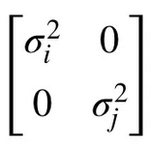
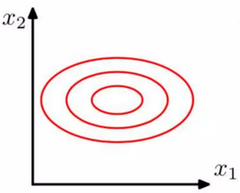
Remark #3
In practice we very frequently restrict the covariance matrix to be diagonal
  In the simplest case by simply ignoring the elements outside the main diagonal
  Easier to train (less stability problems)
  Faster to evaluate (no matrix inversion)
  Of course, the model becomes less accurate (larger “model error”)…
The resulting model is basically equivalent to the Naïve Bayes approach

Slide 22
Bayesian parameter estimation
ML approach: θ has a fixed, but unknown value
Bayesian method: θ is a stochastic value with its own distribution
  this distribution expresses our uncertainty about the actual value of θ
  we are uncertain we have a strong hypothesis (-2)
We assume that we know the a priori distribution P(θ)
Using the D training samples, we are looking for P(θ | D) -t, the posterior distribution of θ, which will eventually give us P(x | D)

Slide 23
Bayesian parameter estimation #2
As the final goal, we want to estimate P(x | D), which will be obtained as
That is, instead of having a point estimate for θ, we marginalize over the possible values of the unknown parameter θ
  If P(θ | D) turns out to be “pointy”, then the result will be very similar to that of the ML method
During classification, we use P(x | D) to estimate p(x|c_{i})
  D contains only the examples of the given class

Slide 24
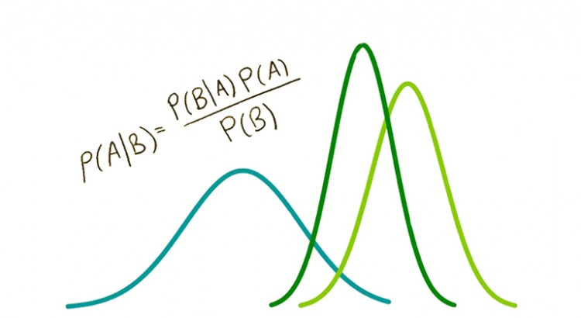
Bayesian parameter estimation #3
As earlier we assume that all the distributions have a Gaussian shape, and only their parameters are unknown
  In practice we can use other distributions as well
Notations:
a priori distribution of θ (it is known!)
Posterior distribution of θ, estimated from n data samples
The distribution of x for a given θ value

Slide 25
Example
Example: univariate case (so μ and σ² are real numbers)
  σ² is known, we have to estimate only μ
  So we will not use the θ notation in this example
Actually we estimate P(μ|D). First use the Bayes theorem:
…then we assume that the examples are independent:
…which gives:

Slide 26
Example #2
So: (recap)
And we also assumed that our distribution is Gaussian:
The two gives (…after a long struggle) :
  …where is the mean of the training sampes

Slide 27
Discussion
μ_{n} is practically the weighted average of and μ₀:
If the sample size n increases, α goes to 1, 1-α to 0
  So we rely more on the estimation based on the data, and rely less on the a priori knowledge
The variance of the estimate gets smaller as the sample size n increases
  So our uncertainty regarding μ_{n} decreases
  …we are still estimating the a posteriori distribution of θ

Slide 28
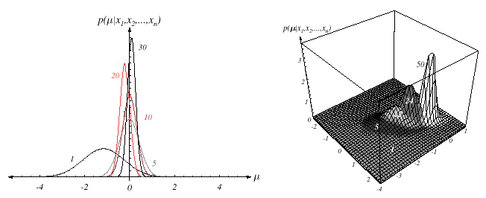
Illustration
The numbers correspond to n:
With the increase of n, the mean converges to a fixed value
The variance gets smaller and smaller, representing that our uncertainty about the actual value decreases

Slide 29
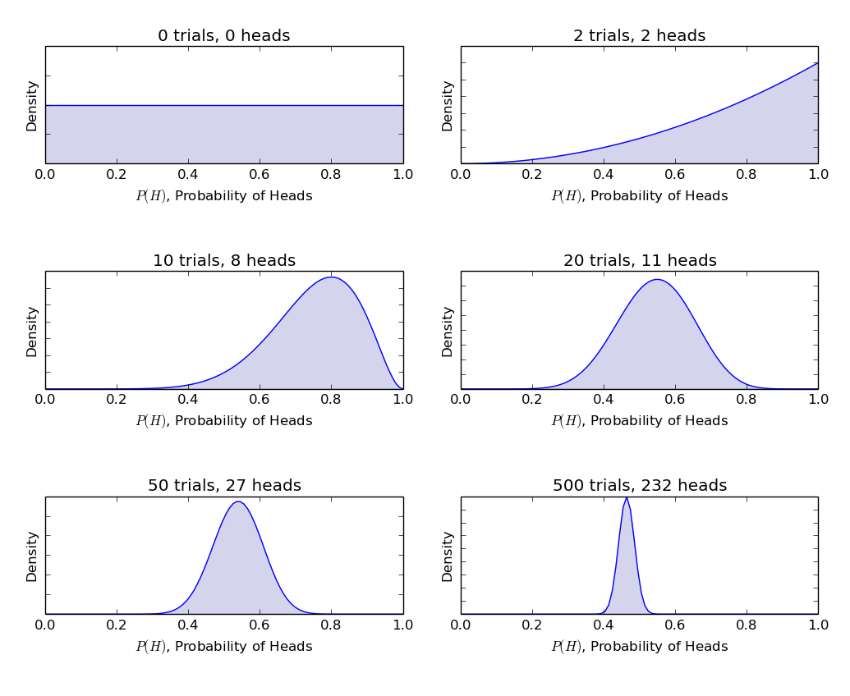
Illustration #2
With the increase of n, the mean converges to a fixed value
The variance gets smaller and smaller, representing that our uncertainty about the actual value decreases

Slide 30
Obtaining P(x | D)
Now we have P(μ|D), but we need P(x|D)
Recall that:
It can be derived that P(x|D) is a normal distribution:
  That is, the Bayesian estimate for the expectation will be μ_{n}
  while for the variance we get σ_{n}+σ, where σ is known, and σ_{n}, expresses the models uncertainty about the estimate (converging to zero as n increases…)
In the multivariate case we would obtain very similar results:
For large n it converges to the same estimates as ML optimization!

Slide 31
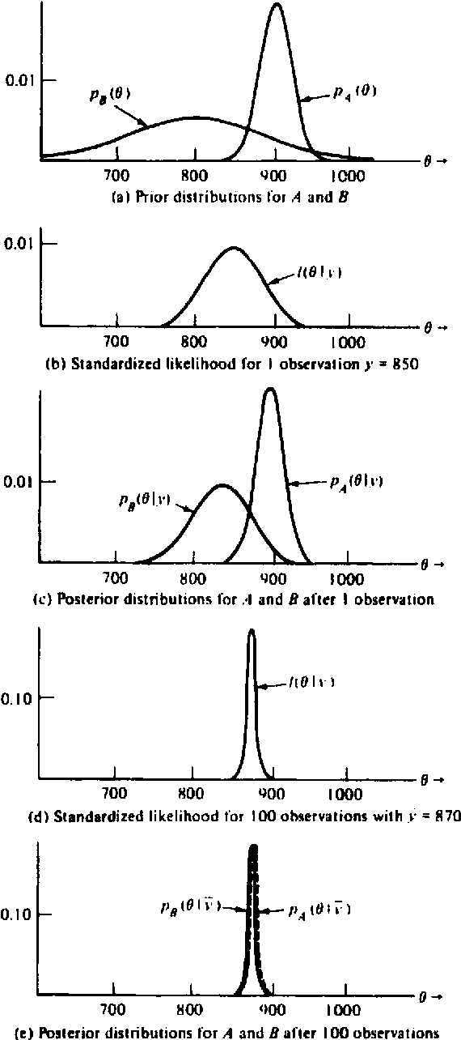
Bayesian method, general case
It can give an estimate for P(x | D) in all cases when we assume some parametric form about the distribution
Assumptions:
  The shape of P(x | θ) is known, we seek the exact θ value
  We have some a priori knowledge about θ, represented as P(θ)
  Our remaining knowledge about θ is represented as n training samples D = { x₁, x₂, …, x_{n} } from P(x)
The solution will consist of two steps:
  (1) we derive P(θ | D), (2) then we derive P(x | D) -t

Slide 32
Bayesian method, general case #2
For the first step we need the assumption of independence and Bayes’ formula:
For the second step we have to calculate:
In the general case it is not easy to compute formally
  In such cases we approximate it numerically (e.g. via Gibbs algorithm), or simply by taking its maximum

Slide 33
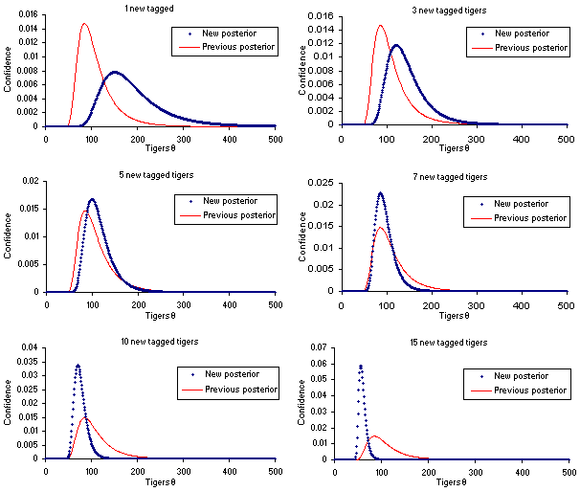
Remark
The Bayesian method can be straightforwardly applied for adapting our model, if we obtain further training samples

